Slide 1



AOCS/SQT Amino Acid Round Robin Study
J. V. Simpson and Y. Zhang
National Corn-to-Ethanol Research Center
Edwardsville, IL
Richard Cantrill
Technical Director
AOCS, Urbana, IL
Amy Johnson
Soybean Quality Traits Program (SQT)
AOCS, Urbana, IL
Lars Reimann
Eurofins Scientific, Inc.
Memphis, TN

Slide 2
Phase I Study
08/2009 - 06/2010
Goal of study can be described in two parts:
Determine the major differences between the various amino acid (AA) determination methods in terms of accuracy, reproducibility, and repeatability.
  This will be determined independent of amino acid hydrolysis.
Make recommendations and improvements to existing methods through the cumulative data collected from all study participants.

Slide 3
Phase I Study
08/2009 - 06/2010
AA testing, Two steps
AOAC method for acid hydrolysis (AOAC 994.12)
Instrumental quantitation of hydrolysate (HPLC, UPLC, LC/MS/MS, etc.)
Experimental Design
18 samples for each lab
15 amino acids to report (ug / ml) (alanine, arginine, aspartic acid, glycine, glutamic acid, histidine, isoleucine, leucine, lysine, phenylalanine, proline, serine, threonine, tyrosine and valine)
Accuracy (AA-standard (Sigma), NIST food reference material , animal feed and spiked animal feed samples)
Precision (within-batch and between-batch)
Participants
14 labs

Slide 4
Instrument and Derivatization Utilized
Lab A - HPLC Post-Column
Lab B - HPLC Post-Column
Lab D - HPLC Post-Column
Lab E - HPLC Post-Column
Lab I - HPLC Post-Column
Lab M - HPLC Post-Column
Lab N - HPLC Post-Column
Lab F - HPLC Pre-Column
Lab G - HPLC Pre-Column
Lab H - HPLC Pre-Column
Lab C - UPLC Pre-Column
Lab K - UPLC Pre-Column
HPLC Post
8
HPLC Pre
3
UPLC Pre
2
Lab J - HPLC Post-Column
Lab L - LC/MS/MS Pre-Column
LC/MS/MS Pre
1

Slide 5
Sample Preparation
Samples prepared using AOAC method for acid hydrolysis (AOAC 994.12) from:
Soybean meal
DDGS provided by the AAFCO Check Sample program
Swine starter provided by the AAFCO Check Sample program
Poultry feed provided by the AAFCO Check Sample program
Infant/adult Nutritional formula (NIST SRM 1849)

Slide 6
AOCS AA Experimental Design
Methods
Labs
Independent of sample matrix and systematic error
Sigma AA std.
Accuracy
NIST Infant Formula
With sample matrix and independent of systematic error
Spiked Hydrolysates
With sample matrix and systematic error
3 replicates
Within batch, repeatability
Precision
6 measurements over 6 weeks
Between batch

Slide 7
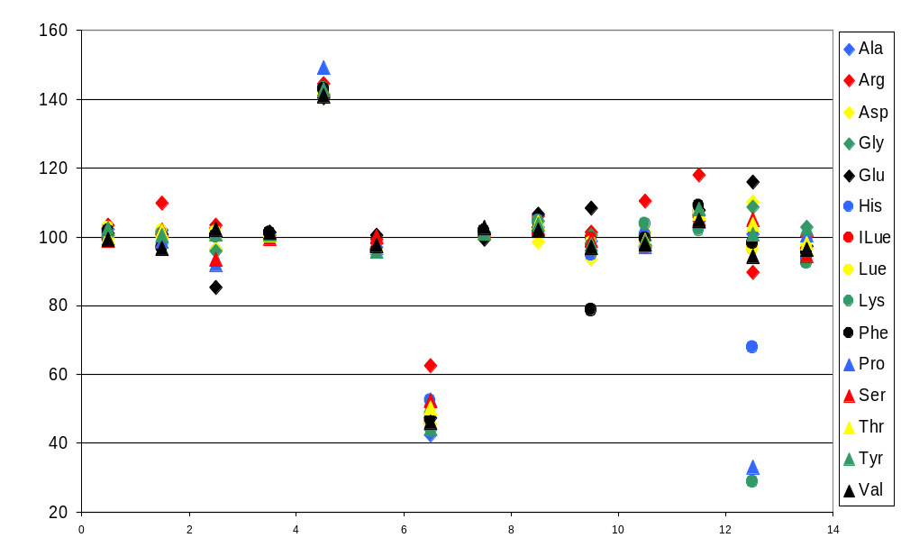
Accuracy (Recovery, %)
(Based on sigma amino acid standard)
Post-HPLC
Pre-HPLC
Pre-UPLC
LC-MS/MS
% Recovery
Lab A B D E I J M N F G H C K L

Slide 8
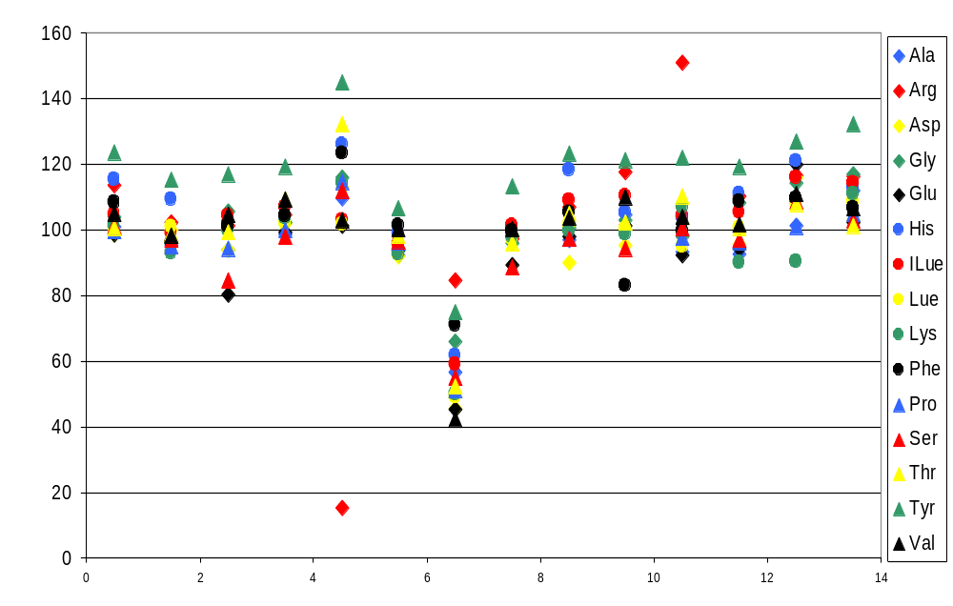
Accuracy (Recovery, %)
(Based on NIST infant formula standard)
Post-HPLC
Pre-HPLC
Pre-UPLC
LC-MS/MS
% Recovery
Lab A B D E I J M N F G H C K L

Slide 9
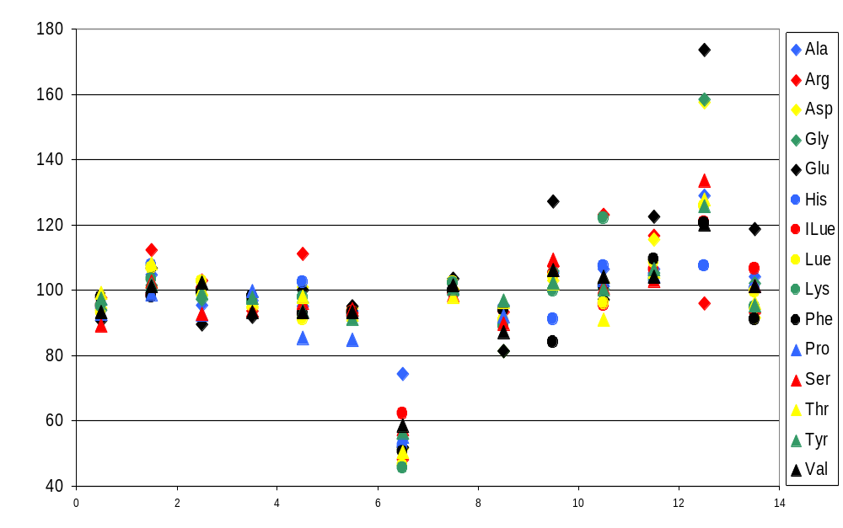
Accuracy (Recovery, %)
(Soybean meal hydrolysate spike)
Post-HPLC
Pre-HPLC
Pre-UPLC
LC-MS/MS
% Recovery
Lab A B D E I J M N F G H C K L

Slide 10
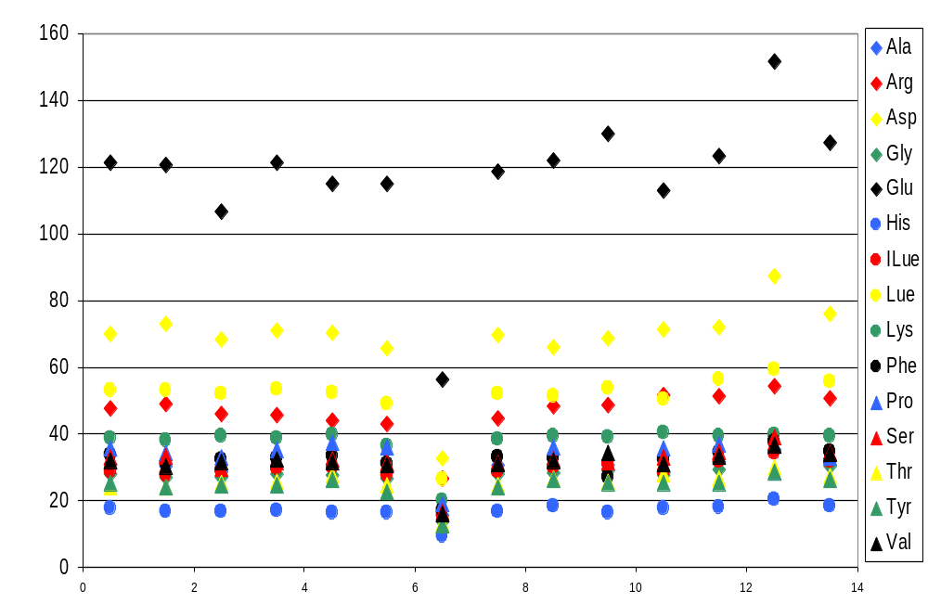
Comparison of Soybean hydrolysate
(mean of triplicates)
Post-HPLC
Pre-HPLC
Pre-UPLC
LC-MS/MS
Amino acid content (µg/mL)
Lab A B D E I J M N F G H C K L

Slide 11
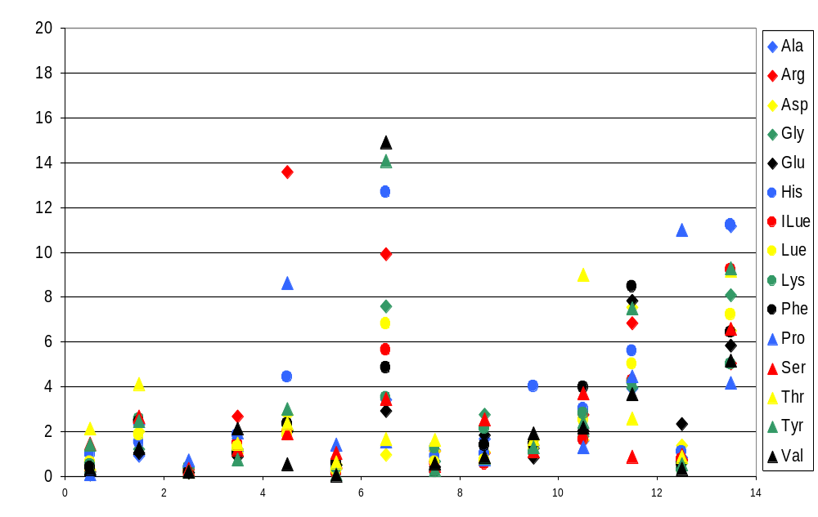
Precision (RSD, %)
(Based on soybean meal hydrolysate triplicate)
Post-HPLC
Pre-HPLC
Pre-UPLC
LC-MS/MS
% RSD
Lab A B D E I J M N F G H C K L

Slide 12
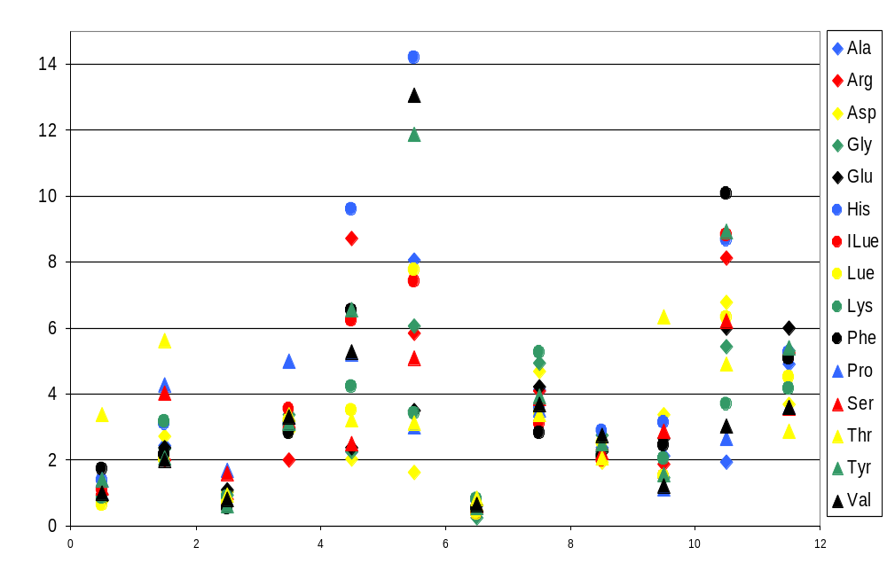
Precision (RSD, %)
(Soybean meal hydrolysate, over 6-week period)
Post-HPLC
Pre-HPLC
Pre-UPLC
LC-MS/MS
% RSD
Lab A B D E I M N F G H C L

Slide 13
Comments
Significance of error in the data:
Error between labs may be greater than the error between methods
Masks the error between methods
All labs should include a reference material in every batch of samples, such as NIST SRM
Use of an internal standard should be included in the sample pretreatment phase, after hydrolysis.

Slide 14
Phase II Study
08/2010 - 03/2011
Goal of study can be described in two parts:
Determine the major differences between the various hydrolysis procedures used by each lab participant that affect accuracy and repeatability.
2. Make recommendations and improvements to existing hydrolysis procedures through the cumulative data collected from all study participants.

Slide 15
Experimental Design
● Each lab participant will receive 5 animal feed samples (including NIST SRM) and hydrolyze each sample once a week for three weeks
● All the hydrolysate samples will be collected and tested for 15 amino acids by one participating lab in the U.S.

